Slide 1

MACHINE LEARNING
By- srivijayalakshmi

Slide 2
MACHINE LEARNING
It is a type of AI that allows software application to become more accurate at predicting outcome without being explicitly programmed to do so.

Slide 3
ARTIFICIAL INTELIGENCE
Artificial intelligence is the simulation of human intelligence in machines.
Human intelligence refers to the cognitive abilities and capacities possessed by humans, including the ability to learn, reason, solve problems, make decisions, understand language, and exhibit creativity.

Slide 4
TYPES OF LEARNING
UNSUPERVISED LERANING
02
REINFORCEMENT LEARNING.
03
SUPERVISED LEARNING.
01

Slide 5
SUPERVISED LEARNING
Learning from others
Contains features and labels
Classification and regression
EXAMPLE:
A simple real-life example of supervised learning is teaching a computer algorithm to classify emails as "spam" or "not spam." In this case, a dataset of labeled emails is provided, where each email is tagged as either spam or not spam. The algorithm learns from this labeled data, identifying patterns and features that distinguish spam emails from non-spam ones. Once trained, the algorithm can accurately classify new, unseen emails as spam or not spam based on the patterns it has learned.

Slide 6
UNSUPERVISED LEARNING
Learning on your own
It contains only features
Clustering and association
EXAMPLE:
A simple real-life example of unsupervised learning is clustering customer data for market segmentation. Let's say a company has a large dataset containing various customer attributes such as age, income, purchase history, and browsing behavior. By applying an unsupervised learning algorithm like k-means clustering, the data can be grouped into distinct clusters based on similarities in these attributes. This allows the company to identify different customer segments with similar characteristics and preferences. The algorithm discovers patterns and relationships within the data without any predefined labels or guidance, enabling the company to gain insights and tailor their marketing strategies for each customer segment.

Slide 7
REINFORCEMENT LEARNING
Learning with the help of rewards and penalty.
Learning through trial and error seeking maximum rewards.
EXAMPLE:
Dog is given treat based on whether he does a given task or not .

Slide 8
ALGORITHM
REGRESSION
CLASSIFICATION
Regression is a technique for investigating the relationship between independent variables or features and a dependent variable or outcome.
It's used as a method for predictive modelling in machine learning, in which an algorithm is used to predict continuous outcomes.
Classification is the task of predicting a discrete class
Label in general, is a function that weighs the input features so that the output separates one class into positive values and the other into negative values, that is categorical segregation .

Slide 9
PYTHON LIBRARIES
NUMPY: PYTHON NUMBER PROCESSING LIBRARY
SCIPY: SCIENTIFIC PYTHON PROCESSING LIBRARY
MATPLOTLIB: TO PLOT GRAPH
PANDAS: USED FOR DATA ANALYSIS
SCIKIT LEARN: MACHINE LEARNING LIBRARY INSIDE PYTHON

Slide 10
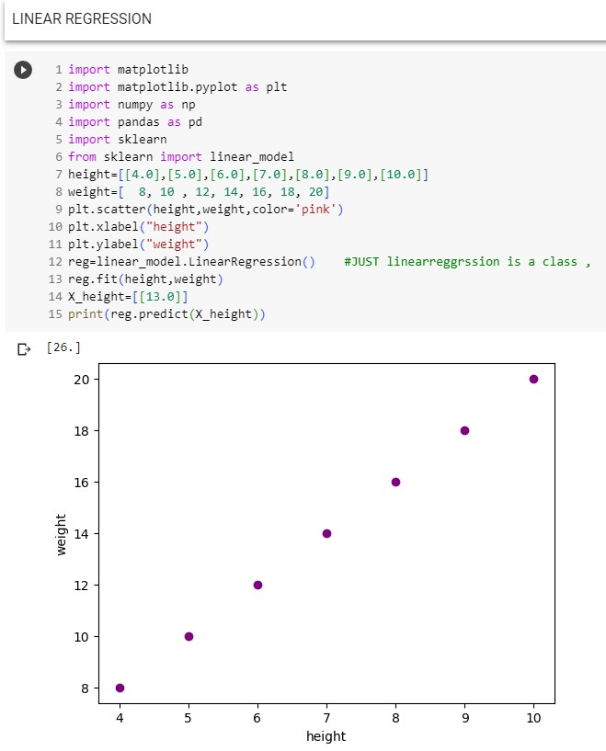
Linear Regression:
In this process, a relationship is established between independent and dependent variables by fitting them to a line . This line and represented by a linear equation y = mx+c

Slide 11
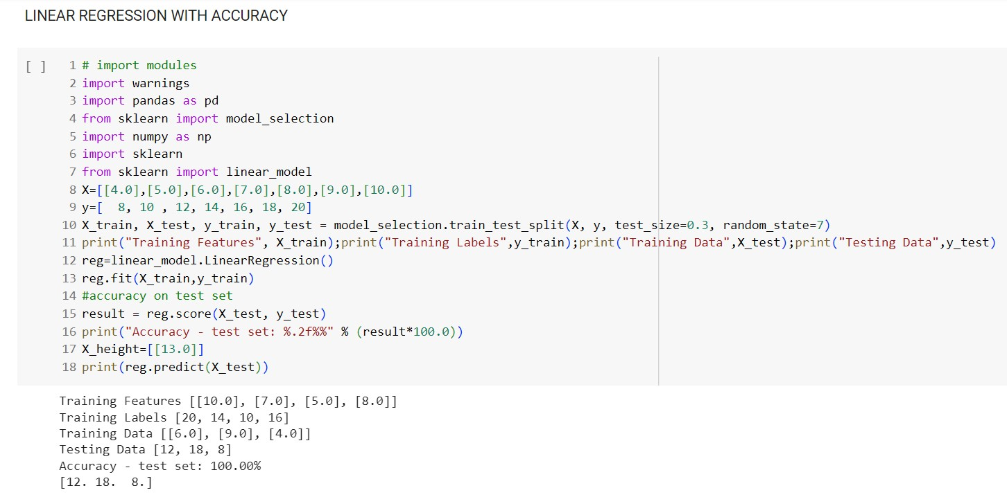

Slide 12
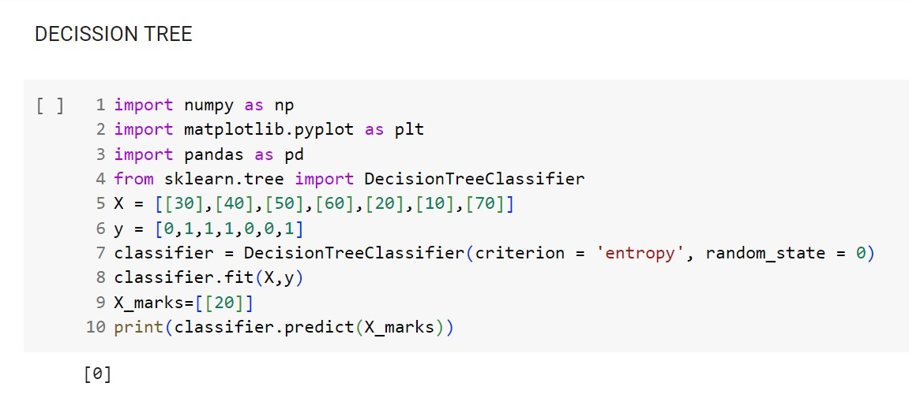
Decision tree:
This is a supervised learning algorithm that is used for classification problems. In this algorithm we split the population into two /more homogenous sets based on the most significant attributes/ independent variables.

Slide 13
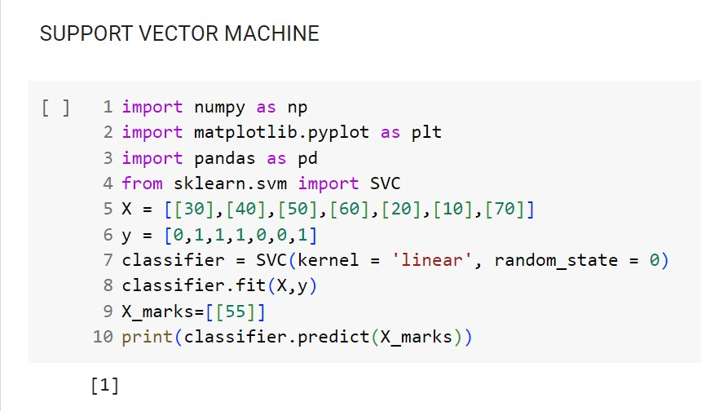
SVM:
In this algorithm, we plot raw data as points in an n-dimensional space. The value of each feature is tied to a particular coordinate, making it easy to classify the data.

Slide 14
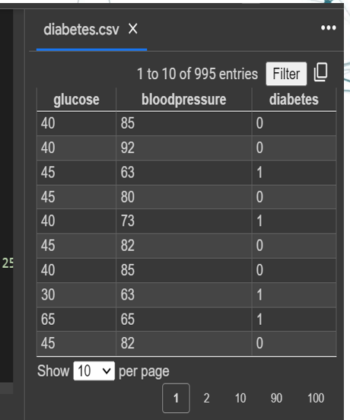
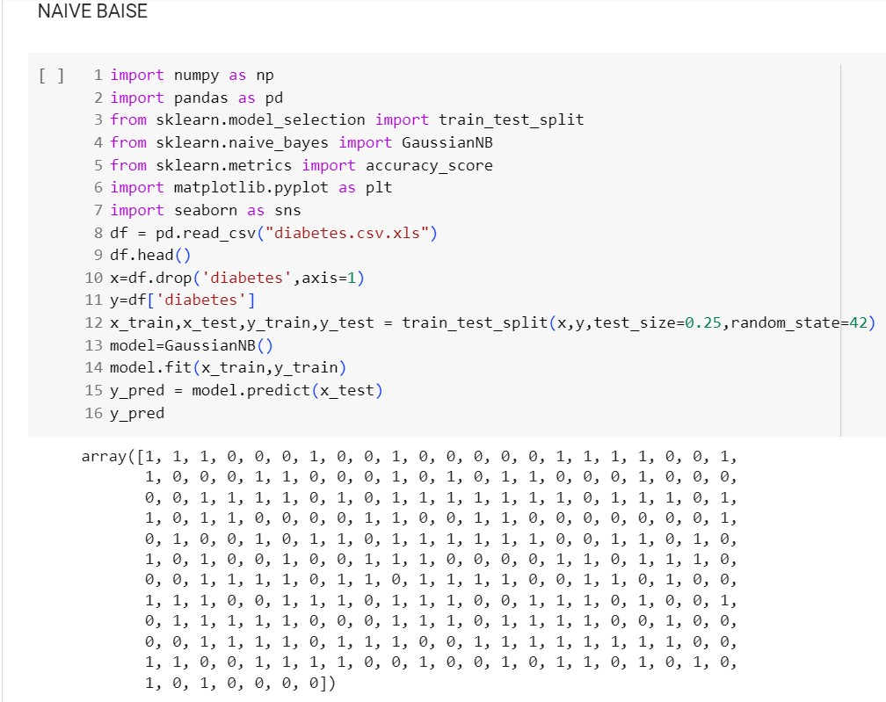
Naive Bayes :
A Naive Bayes classifier assumes that the presence of a particular feature in a class is unrelated to the presence of any other feature.

Slide 15
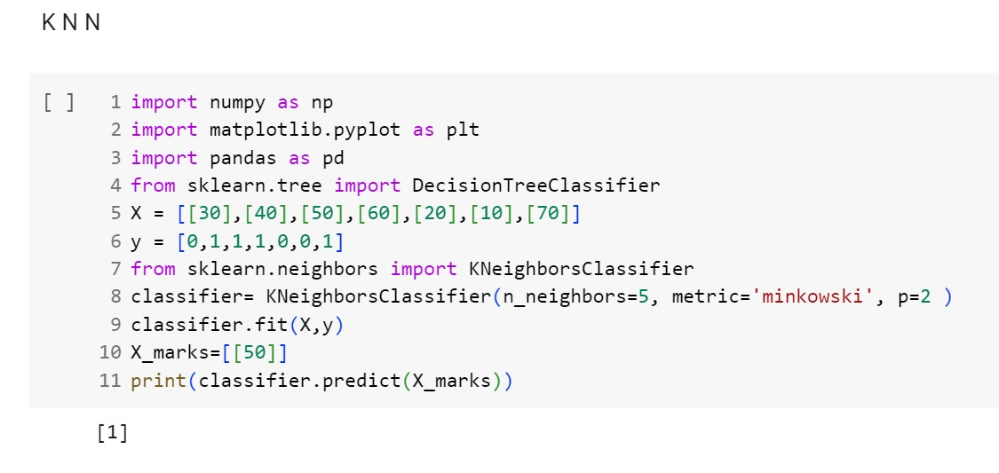
KNN :
This can be applied to both classification and regression problems. It stores all the cases and classifies any new cases by taking a majority vote of its k neighbours. The case is then assigned to the class with which it has the most in common.

Slide 16
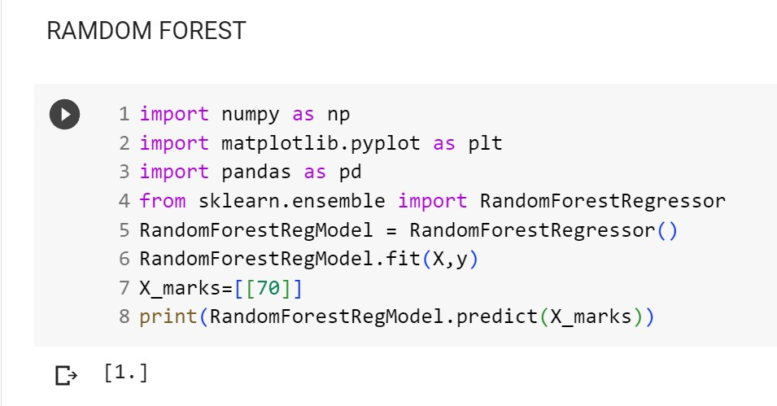
Random Forest:
A collective of decision trees is random forest. To classify new object
based on its attributes, each tree is classified and the tree votes for that
class. The forest chooses the classification having the most votes.

Slide 17
STEPS INVOLVED IN MACINE LEARNING
GET/COLLECT DATA
IDENTIFING ALGORITHM
FIT( BUILD THE MODEL BY TAKING INPUT AND OUTPUT)
PREDICT( TAKES INPUT AND PREDICTS OUTPUT USING MODEL)
SCORE(CHECKING ACCURACY)

Slide 18
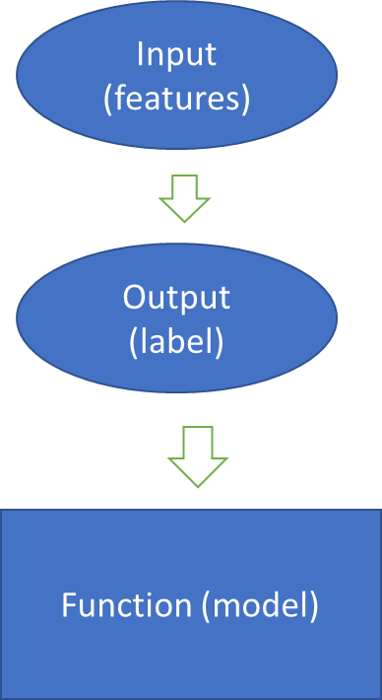
FEATURES AND LABLES
FEATURES
Blood pressure , Glucose
LABLES
Diabetics or not

